Slide 1
Queues
© 2013 Goodrich, Tamassia, Goldwasser
Queues
Notes:
Queues

Slide 2
The Queue ADT
The Queue ADT stores arbitrary objects
Insertions and deletions follow the first-in first-out scheme
Insertions are at the rear of the queue and removals are at the front of the queue
Main queue operations:
  enqueue(object): inserts an element at the end of the queue
  object dequeue(): removes and returns the element at the front of the queue
Auxiliary queue operations:
  object first(): returns the element at the front without removing it
  integer len(): returns the number of elements stored
  boolean is_empty(): indicates whether no elements are stored
Exceptions
  Attempting the execution of dequeue or front on an empty queue throws an EmptyQueueException
© 2013 Goodrich, Tamassia, Goldwasser
Queues
Notes:
Queues

Slide 3
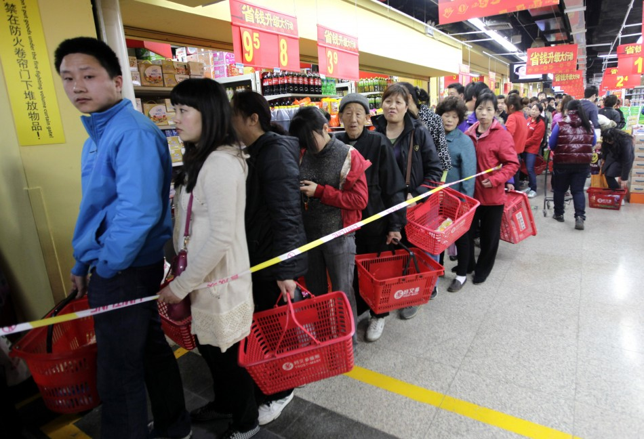
Queues
First In First Out (FIFO)
  Remove the least recently added item
  A queue has a front and a rear
  Analogy: waiting lines at the supermarket

Slide 4
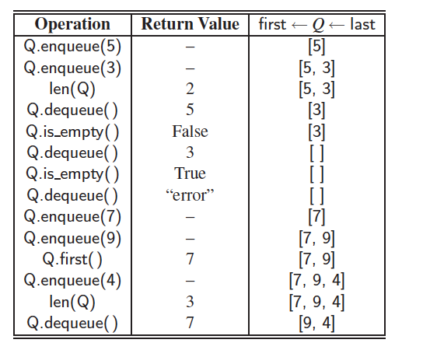
Example (conceptual view)
© 2013 Goodrich, Tamassia, Goldwasser
Queues

Slide 5
Applications of Queues
Direct applications
  Waiting lists, bureaucracy
  Access to shared resources (e.g., printer)
  Multiprogramming
Indirect applications
  Auxiliary data structure for algorithms
  Component of other data structures
© 2013 Goodrich, Tamassia, Goldwasser
Queues

Slide 6
Let’s implement a queue (FIFO)
Define a Queue class having following methods:
  __init__(self): #Initialize a queue
  __len__(self): #Return length of queue
  is_empty(self): #Return True if queue is empty
  enqueue(self,e): #Enqueue element e in the queue.
  dequeue(self): return an element from the queue and delete that element.
  front(self): returns the element at the front without removing it
© 2013 Goodrich, Tamassia, Goldwasser
Queues

Slide 7
Array-based Queue (Concept)
Use an array of size N in a circular fashion
Two variables keep track of the front and size
  f index of the front element
  size # of elements in Queue
r can be computed based on modulo: (f+size) % N
normal configuration
Q
0
1
2
f
r
wrapped-around configuration
Q
0
1
2
r
f
© 2013 Goodrich, Tamassia, Goldwasser
Queues

Slide 8
Example
By default: f = 0. But it is NOT a hard requirement!
f
Queue status:
len(data) = 10
size = 0
f = 9
0 1 2 3 4 5 6 7 8 9
Enqueue(e): Put e into the available slot, update size
Dequeue(): remove the first element and return it; Then update f & size:
© 2013 Goodrich, Tamassia, Goldwasser
Queues

Slide 9
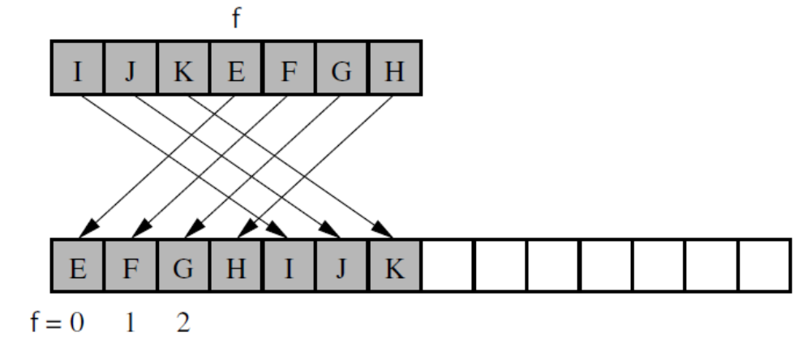
Resizing the Queue
(Queue in Python (text book), continued)
Create a new array of double size (doubling strategy)
Copy each element starting from index f=3,4,5,6,0,1,2 to 0,1,2,3,4,5,6
Use % operator!
size=7
0
1
2
3
4
5
6
© 2013 Goodrich, Tamassia, Goldwasser
Queues
Notes:
Like in Dynamic array, resizing happens when the capacity of queue is full.
Queues

Slide 10
Queue in Python (text book)
Use the following three instance variables:
  _data: is a reference to a list instance with a fixed capacity.
  _size: is an integer representing the current number of elements stored in the queue (as opposed to the length of the data list).
  _front: is an integer that represents the index within data of the first element of the queue (assuming the queue is not empty).
© 2013 Goodrich, Tamassia, Goldwasser
Queues
Notes:
This is a different implementation of queue. Just keep the front pointer and the current size of queue.
Queues

Slide 11
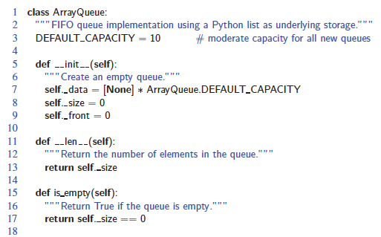
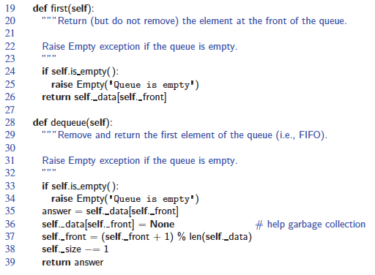
Queue in Python (text book), Beginning
© 2013 Goodrich, Tamassia, Goldwasser
Queues

Slide 12
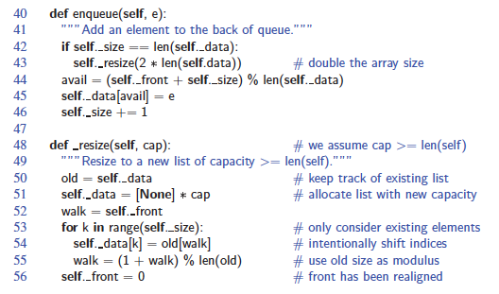
Queue in Python (text book), Continued
© 2013 Goodrich, Tamassia, Goldwasser
Queues
Notes:
Queues

Slide 13
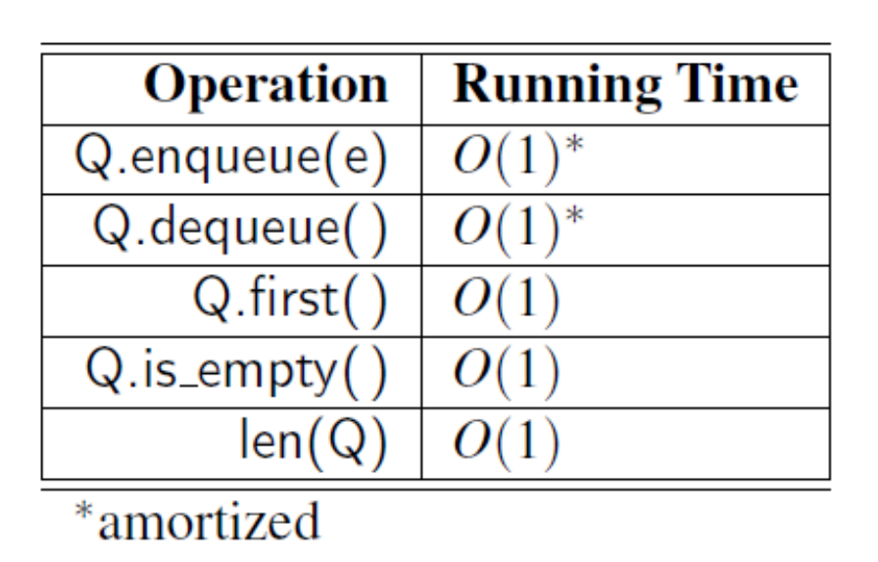
Analyzing the Array-Based Queue
© 2013 Goodrich, Tamassia, Goldwasser
Stacks

Slide 14
Queue in Python (Our Approach)
Our Queue will be Fixed Size. It won’t be automatically increase or decrease. If it’s full, we will throw an FullQueueException.
Use the following three instance variables:
  _data: is a reference to a list instance with a fixed capacity.
  _size: is an integer representing the current number of elements stored in the queue (as opposed to the length of the data list).
  _front: is an integer that represents the index within data of the first element of the queue (assuming the queue is not empty).
© 2013 Goodrich, Tamassia, Goldwasser
Queues

Slide 15
Adding and Removing Elements
(Queue in Python, Our Approach)
In enqueuer(self, e):
  avail = (self._front + self._size) % len(self._data)
  self._data[avail] = e
  self._size += 1
In dequeuer(self)
  answer = self._data[self._front]
  self._data[self._front] = None
  self._front = (self._front + 1) % len(self._data)
  self._size −= 1
  return answer
© 2013 Goodrich, Tamassia, Goldwasser
Queues
Notes:
Queues

Slide 16
Analyzing the Array-Based Queue (Our Approach)
What will be runtime complexity?
Operation | Running Time
Q.enqueue(e) | ???
Q.dequeue() | ???
Q.first() | ???
Q.is_empty() | ???
len(Q) | ???
© 2013 Goodrich, Tamassia, Goldwasser
Stacks

Slide 17
Analyzing the Array-Based Queue (Our Approach)
Operation | Running Time
Q.enqueue(e) | O(1)
Q.dequeue() | O(1)
Q.first() | O(1)
Q.is_empty() | O(1)
len(Q) | O(1)
© 2013 Goodrich, Tamassia, Goldwasser
Stacks
Notes:
No amortized Big-O due to no resizing.

Slide 18
Application: Round Robin Schedulers
We can implement a round robin scheduler using a queue Q by repeatedly performing the following steps:
  e = Q.dequeue()
  Service element e
  Q.enqueue(e)
Queue
Dequeue
Enqueue
Shared
Service
© 2013 Goodrich, Tamassia, Goldwasser
Queues
Notes:
Queues

Slide 19
Double Ended Queue (Deck) ADT
D.add_first(e): Add element e to the front of deque D.
D.add_last(e): Add element e to the back of deque D.
D.delete_first( ): Remove and return the first element from deque D; an error occurs if the deque is empty.
D.delete_last( ): Remove and return the last element from deque D; an error occurs if the deque is empty.
D.first(): Return (but do not remove) the first element of deque D;
an error occurs if the deque is empty.
D.last(): Return (but do not remove) the last element of deque D;
an error occurs if the deque is empty.
D.is_empty( ): Return True if deque D does not contain any elements.
len(D): Return the number of elements in deque D;
© 2013 Goodrich, Tamassia, Goldwasser
Queues
Notes:
Will cover more during recitation
Queues

Slide 20
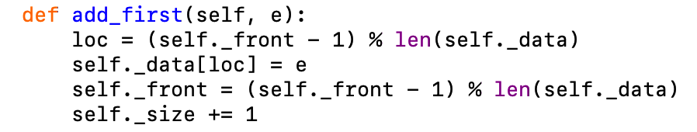
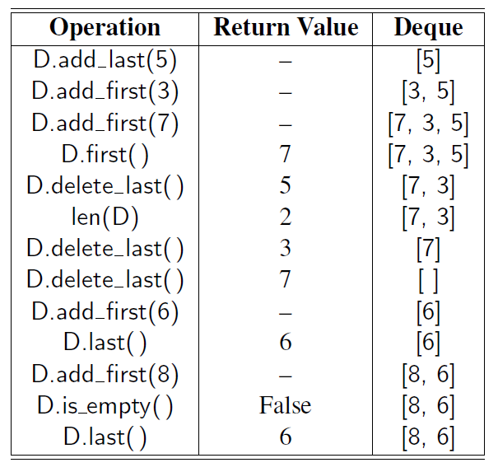
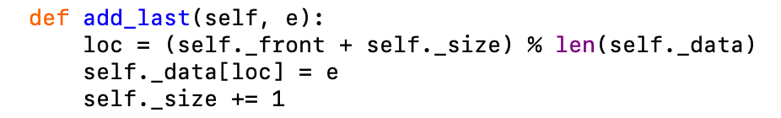
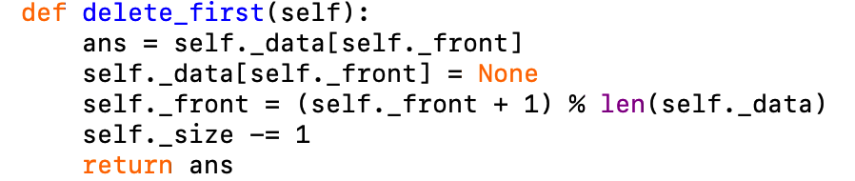
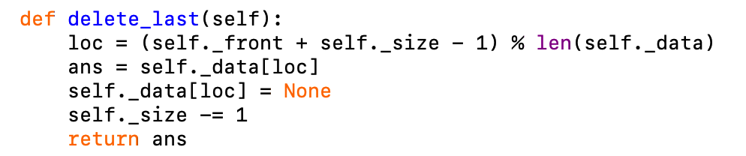
f
Deque status:
len(data) = 10
size = 0
f = 0
0 1 2 3 4 5 6 7 8 9

